Slide 1
MATHEMATICAL MODELING AND DYNAMIC ANALYSIS OF A MULTI-TERRAIN FOUR-WHEELED ROBOT
Team: Ananya Verma, Sneha Waghode, Anusha Surve
Course: Dynamic System Modeling (702MH0C023)
B.Tech Mechatronics, Sem IV | NMIMS MPSTME Mumbai
Category: A | Complexity:High
COs Exercised: [CO1, CO2, CO3, CO4, CO5] | Date: 20/04/2026

Slide 2
1. System Introduction & Motivation
What is the system?
The system is a multi-terrain mobile robotic platform that combines wheels and leg-like suspension (quadrupedal mechanism) to move efficiently across uneven, rough, and complex terrains.
More specifically, it is a hybrid quadrupedal-wheeled robot with:
Active suspension using servomotors
Four-bar linkage mechanism for each leg
Skid-steering drive system
Independent wheel actuation
This design allows the robot to:
Adjust its ground clearance dynamically
Maintain stability on slopes and obstacles
Move using wheels while adapting like a legged system
Why does it matter? (Engineering application)
This system is important because traditional wheeled robots struggle on uneven or off-road environments, while purely legged robots are complex and expensive.
This hybrid approach solves that gap.
Key engineering applications:
Search and rescue missions (disaster zones, rubble)
Military and surveillance robots
Planetary exploration (e.g., Mars rovers)
Agricultural field robots
Remote sensing in rough terrains

Slide 3
What question are we answering? (PBL problem statement)
Problem Statement:
How can a multi-terrain robotic system be developed using a hybrid quadrupedal-wheeled mechanism with active suspension to ensure dynamic stability, adaptive ground clearance, and efficient locomotion across rough and unstructured environments?
Answer:
First, the robot uses a quadrupedal structure combined with wheels, where each leg is equipped with a wheel. This allows the system to:
  Move efficiently on flat surfaces like a wheeled robot
  Adapt to uneven terrain like a legged robot
Second, an active suspension system using servomotors is implemented. These servomotors control the position of each leg through a four-bar linkage mechanism, enabling:
  Adjustment of ground clearance based on terrain conditions
  Maintenance of balance on slopes and irregular surfaces
  Reduction of mechanical stress using shock absorbers
Third, dynamic stability is ensured through mathematical modeling, particularly:
  Helps maintain the robot’s center of gravity within safe limits
  Control of pitch and roll motion to prevent overturning
Additionally, a skid-steering mechanism is used for locomotion. This allows the robot to:
Change direction without complex steering linkages
Improve maneuverability in confined or rough environments
Notes:
TIMING: 0:00-1:00 (1 min)
FOCUS: Introduce your system and its real-world engineering relevance.
TIP: Start with a compelling application, not a textbook definition.
SHOW: An image or short video of the actual system.

Slide 4
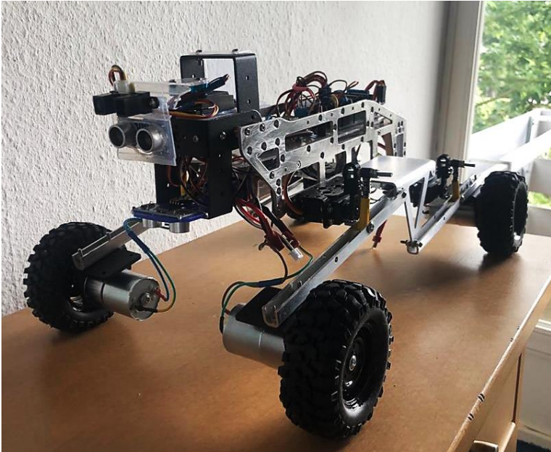
Real life image

Slide 5
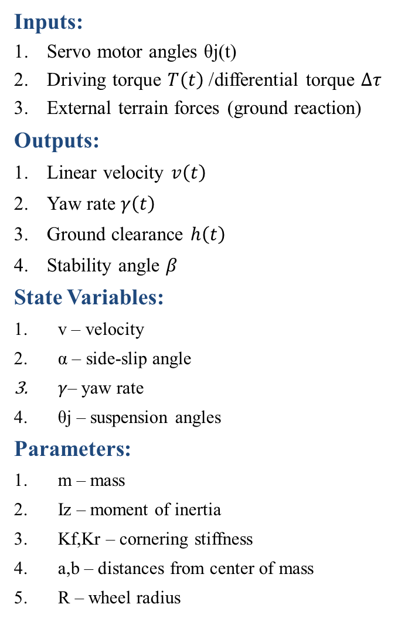
2. Problem Formulation & Assumptions
Inputs:
Servo motor angles θj​(t)
Driving torque $T\left(t\right)$/ differential torque $Δτ$
External terrain forces (ground reaction)
Outputs:
Linear velocity $v\left(t\right)$
Yaw rate $γ\left(t\right)$
Ground clearance $h\left(t\right)$
Stability angle $β$
State Variables:
v – velocity
α – side-slip angle
$γ$– yaw rate
θj​ – suspension angles
Parameters:
m – mass
Iz​ – moment of inertia
Kf​,Kr​ – cornering stiffness
a,b – distances from center of mass
R – wheel radius
DOF:
1. Planar Motion DOF (Body) = 2
-Forward/lateral motion
-Yaw (rotation about vertical axis)
2. Suspension DOF = 4
-4 independent servo-controlled joints
-Each leg (wheel assembly) can move vertically via active suspension
Each servo = 1 DOF → 4 DOF
Total DOF = 2 (motion) + 4 (suspension) = 6 DOF
Key assumptions:
Rigid body – deformation negligible
Planar motion – out-of-plane effects ignored
Continuous wheel-ground contact
Small-angle approximation
Symmetric geometry (at 180° configuration)
Viscous damping proportional to velocity
Notes:
TIMING: 1:00-2:30 (1.5 min)
FOCUS: Clearly define I/O, states, parameters, DOF, and justify every assumption.
TIP: Explain WHY each assumption is physically valid.
BE PREPARED: You may be asked 'Why this assumption? What if it changes?'

Slide 6
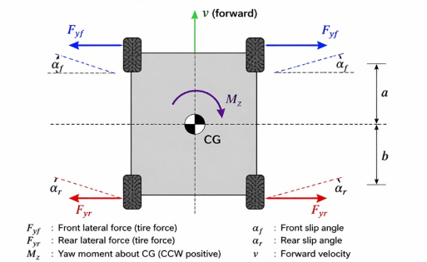
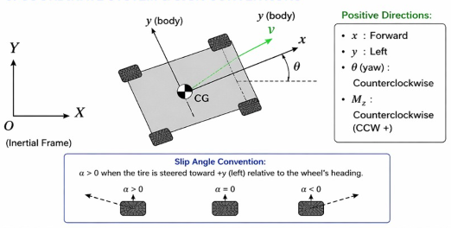
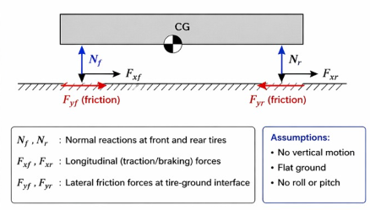
3. Free Body Diagram / System Schematic

Slide 7

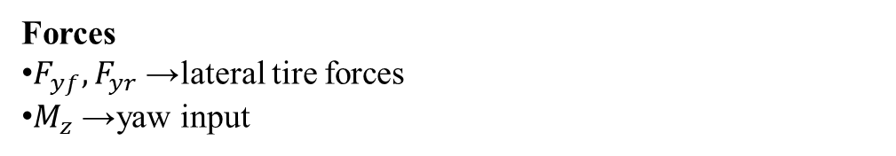
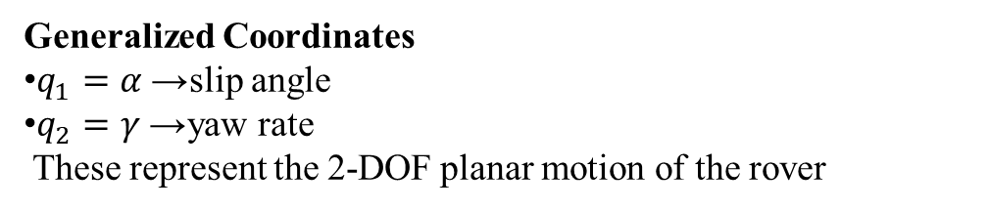
4. Mathematical Derivation
Newton’s method is chosen because forces and moments acting on the rover are clearly identifiable from the Free Body Diagram. It provides a direct physical interpretation of lateral forces and yaw moment. Suitable for planar rigid body motion with minimal constraints
Generalized Coordinates
$q_{1}=α$→ slip angle
$q_{2}=γ$→ yaw rate
These represent the 2-DOF planar motion of the rover
Forces
$F_{yf},F_{yr}$→ lateral tire forces
$M_{z}$→ yaw input
Energy : $T=\frac{1}{2}mv^{2}+\frac{1}{2}I_{z}γ^{2}, V=0$
Euler–Lagrange $\frac{d}{dt}\left(\frac{∂L}{∂\dot{q}}\right)−\frac{∂L}{∂q}=Q$
Resulting Equations
$mv\left(\dot{α}+γ\right)=F_{yf}+F_{yr}$
$I_{z}\dot{γ}=M_{z}+aF_{yf}−bF_{yr}$
We used Lagrange’s method to derive coupled lateral and yaw equations using energy and generalized forces.
Notes:
TIMING: 2:30-3:45 (1.25 min)
FOCUS: Walk through EVERY step of the derivation. This is the most important section.
TIP: Show the algebra — don't skip to the final equation.
BE PREPARED: You may be asked to explain any step in detail.

Slide 8
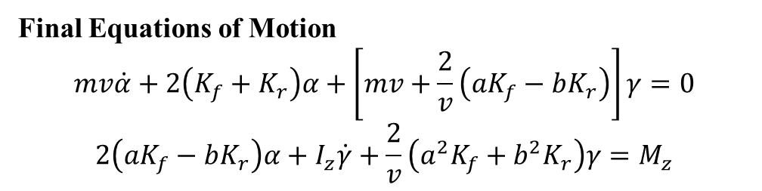
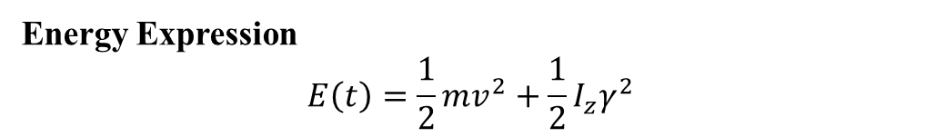
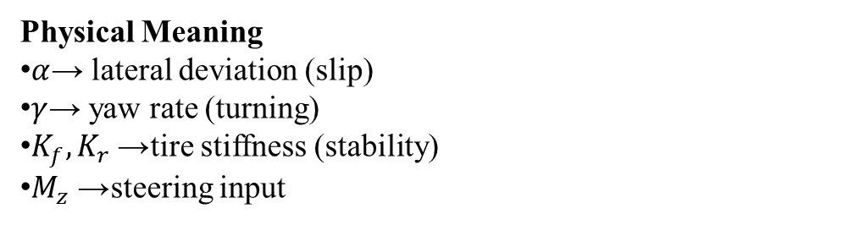

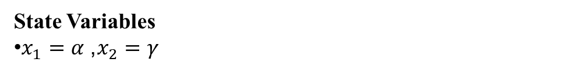
5. Final Equations & State-Space
Final Equations of Motion
$$mv\dot{α}+2\left(K_{f}+K_{r}\right)α+\left[mv+\frac{2}{v}\left(aK_{f}−bK_{r}\right)\right]γ=0$$
$$2\left(aK_{f}−bK_{r}\right)α+I_{z}\dot{γ}+\frac{2}{v}\left(a^{2}K_{f}+b^{2}K_{r}\right)γ=M_{z}$$
Physical Meaning
$α$→ lateral deviation (slip)
$γ$→ yaw rate (turning)
$K_{f},K_{r}$→ tire stiffness (stability)
$M_{z}$→ steering input
State Variables
$x_{1}=α$, $x_{2}=γ$
State-Space Form
$$\dot{x}=\left[\begin{matrix}A_{11} & A_{12} \\ A_{21} & A_{22}\end{matrix}\right]x+\left[\begin{matrix}0 \\ \frac{1}{I_{z}}\end{matrix}\right]M_{z}$$
Energy Expression
$$E\left(t\right)=\frac{1}{2}mv^{2}+\frac{1}{2}I_{z}γ^{2}$$
Notes:
TIMING: 3:45-5:00 (1.25 min)
FOCUS: Present final EOM and state-space. Explain the physical meaning of EVERY term.
TIP: 'c*x_dot = viscous damping force' is stronger than just showing the equation.

Slide 9
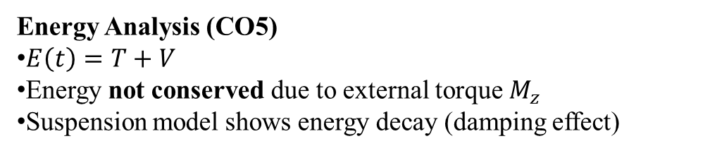
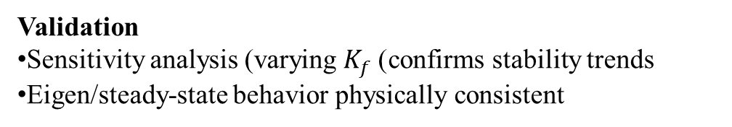
6. Simulation & Energy Analysis
Simulation Setup
ODE solved using: solve_ivp (RK45)
States: slip angle (α), yaw rate (γ)
Initial condition: α₀ = 0.1, γ₀ = 0
Key Results
Stable time response of α and γ
Rover trajectory shows realistic motion
Newton & Lagrange results match (model validated)
Energy Analysis (CO5)
$E\left(t\right)=T+V$
Energy not conserved due to external torque $M_{z}$
Suspension model shows energy decay (damping effect)
Validation
Sensitivity analysis (varying $K_{f}$) confirms stability trends
Eigen/steady-state behavior physically consistent
Notes:
TIMING: 5:00-7:00 (2 min)
FOCUS: Show your simulation setup, key code snippet, and output plots.
INCLUDE: Energy vs time plot — this validates your model physically.
BE PREPARED: You may be asked 'Why does the oscillation decay?' or 'How does energy change?'

Slide 10
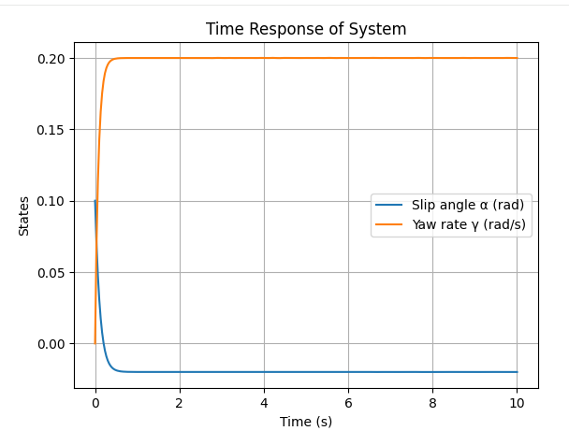
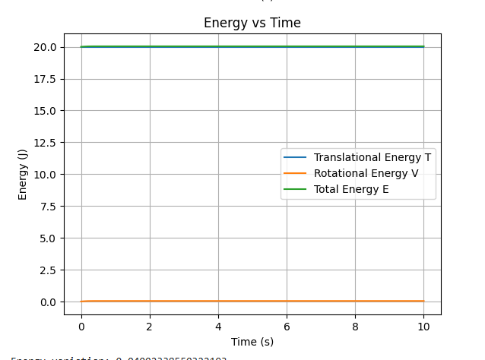
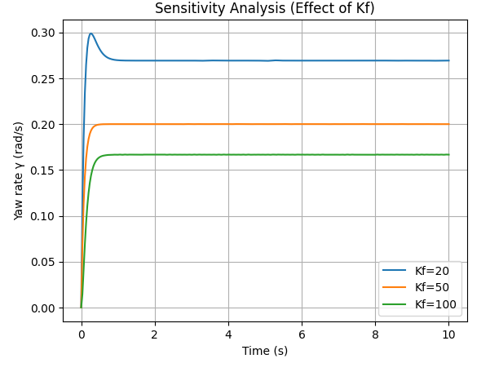
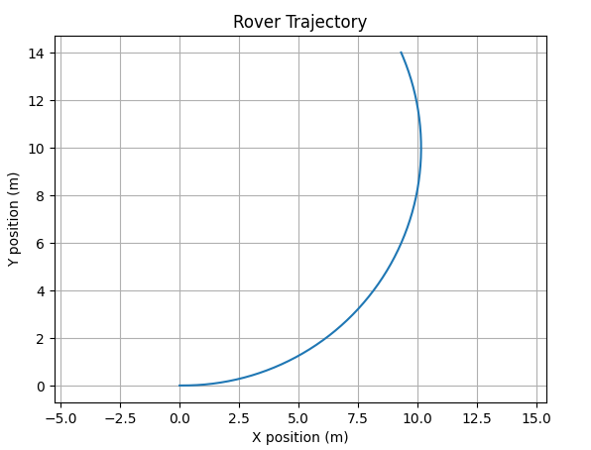
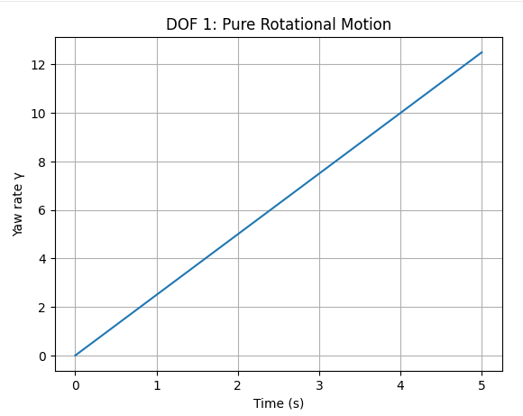
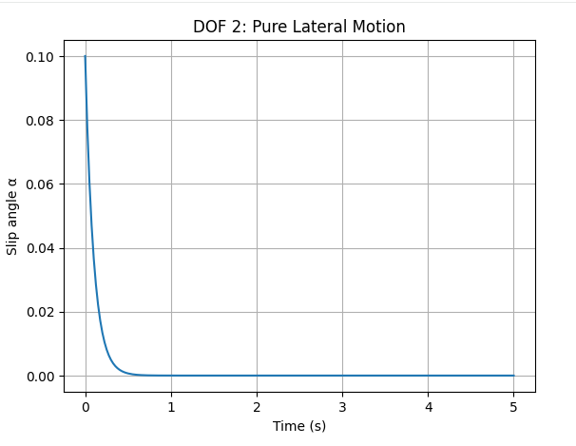
7. Simulation Visualization

Slide 11
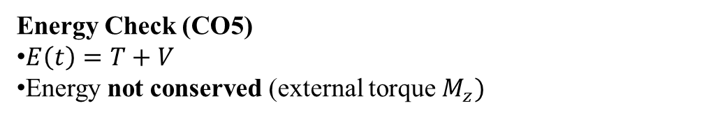
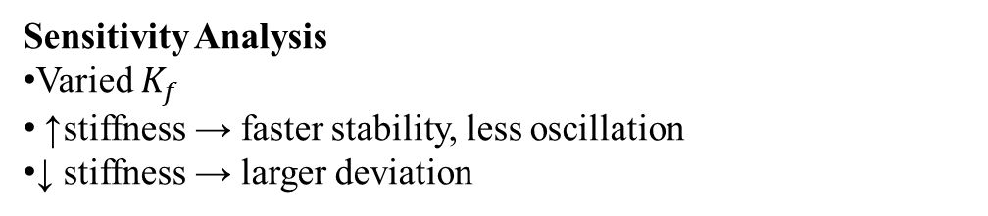
8. Validation & Analysis
Energy Check (CO5)
$E\left(t\right)=T+V$
Energy not conserved (external torque $M_{z})$
Stability Check
Eigenvalues have negative real parts
System is dynamically stable
Model Validation (CO4)
α and γ converge → stable response
Matches expected vehicle dynamics behavior
Limitations
Linear tire model (small slip only)
Constant velocity assumed
No terrain / suspension effects
Sensitivity Analysis
Varied $K_{f}$
↑ stiffness → faster stability, less oscillation
↓ stiffness → larger deviation
Notes:
TIMING: 7:00-8:30 (1.5 min)
FOCUS: Show HOW you verified your results. Energy check, textbook comparison, sensitivity.
TIP: A strong answer = 'We compared natural frequency with Ginsberg Ch.3.'
A weak answer = 'It runs and produces output.'

Slide 12
9. Conclusions & Reflections
Key Finding
The developed rover model successfully captures coupled lateral and yaw dynamics.
Simulation results show stable and physically consistent behavior under applied inputs.
What We Learned
Converting theoretical equations into working simulations (CO4) requires careful handling of assumptions and parameters.
Real system behavior (stability, response) becomes clearer only after simulation and validation.
What We’d Do Differently
Begin simulation and validation earlier in the process
Verify each step of derivation alongside implementation
Explore more realistic factors (e.g., suspension, terrain)
Most Critical Concepts
Free Body Diagram & force identification (CO2, CO3)
Equation of motion derivation (CO4)
Energy analysis and validation (CO5)
Notes:
TIMING: 8:30-10:00 (1.5 min)
FOCUS: Be specific about what you learned and what was hardest.
TIP: 'Getting the sign convention right in the Lagrangian took 3 iterations' is much stronger than 'teamwork was hard.'
INCLUDE: CO self-assessment — which COs did you exercise most?

Slide 13
10. References & AI Disclosure
Research paper References:
Multi-terrain Quadrupedal-wheeled Robot Mechanism: Design, Modeling, and Analysis
AI Tools :
Tool: chat gpt (codex ), claude.ai
Purpose: Python syntax debugging.
NOT used for: Derivation done by hand. Lengarangian method solved by hand
Notes:
AI disclosure is MANDATORY but NOT penalized.
Be honest about what tools you used and for what purpose.
Good: 'Used ChatGPT for Python syntax debugging, derivation done by hand.'
Non-disclosure IS penalized if uncovered during Q&A.

Slide 14
Thank You — Questions?
Team: Ananya Verma, Anusha Surve, Sneha Waghode
Project: Multi-terrain Quadrupedal-wheeled Robot Mechanism
Category: A
COs: [CO1-CO5]

